Slide 1
Common anode and cathod
Aya mohamed sayed sec 1

Slide 2
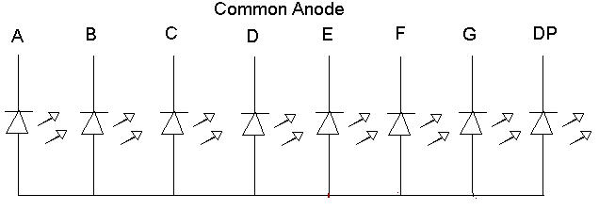
Common anode and cathode
There are two types of LED 7-segment displays: common cathode (CC) and common anode (CA). The difference between the two displays is the common cathode has all the cathodes of the 7-segments connected directly together and the common anode has all the anodes of the 7-segments connected together. Shown below is a common anode seven segment.

Slide 3
Common anode and cathode
As shown above all the anode segments are connected together. When working with a CA seven segment display, power must be applied externally to the the anode connection that is common to all the segments. Then by applying a ground to a particular segment connection (a-g), the appropriate segment will light up. An additional resistor must be added to the circuit to limit the amount of current flowing thru each LED segment.

Slide 4
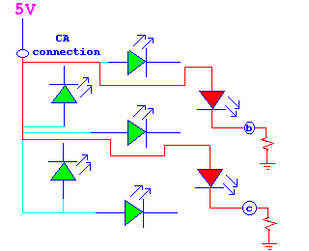
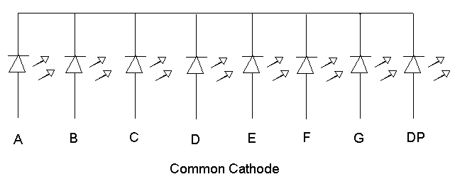
7 segment display
The above diagram shows the instance when power is applied to the CA connection and segments b & c are grounded causing these two segments to light up. A typical pinout for a seven segment common anode display is shown below. common cathode seven segment is different from a common anode segment in that the cathodes of all the LEDs are connected together. For the use of this seven segment the common cathode connection must be grounded and power must be applied to appropriate segment in order to illuminate that segment.

